Slide 1


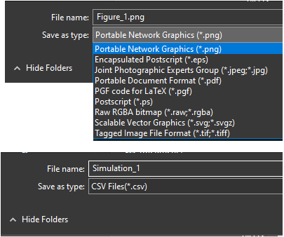
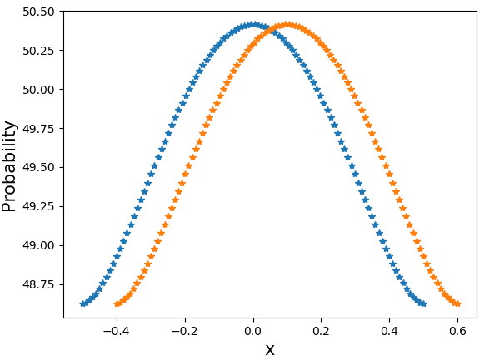
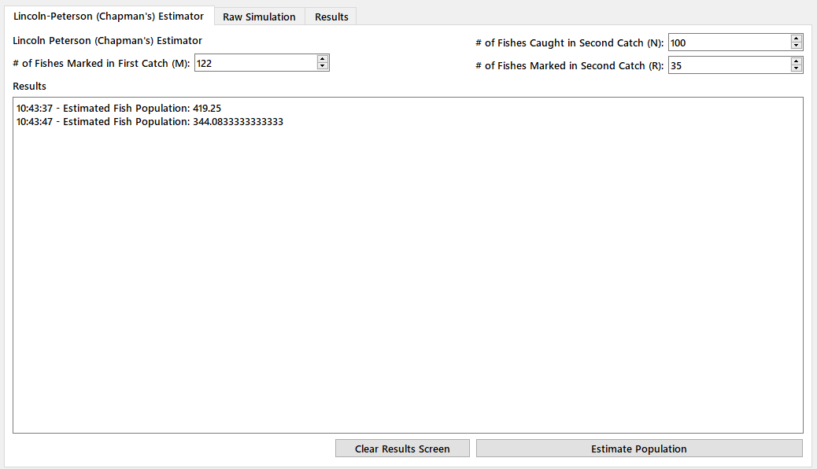
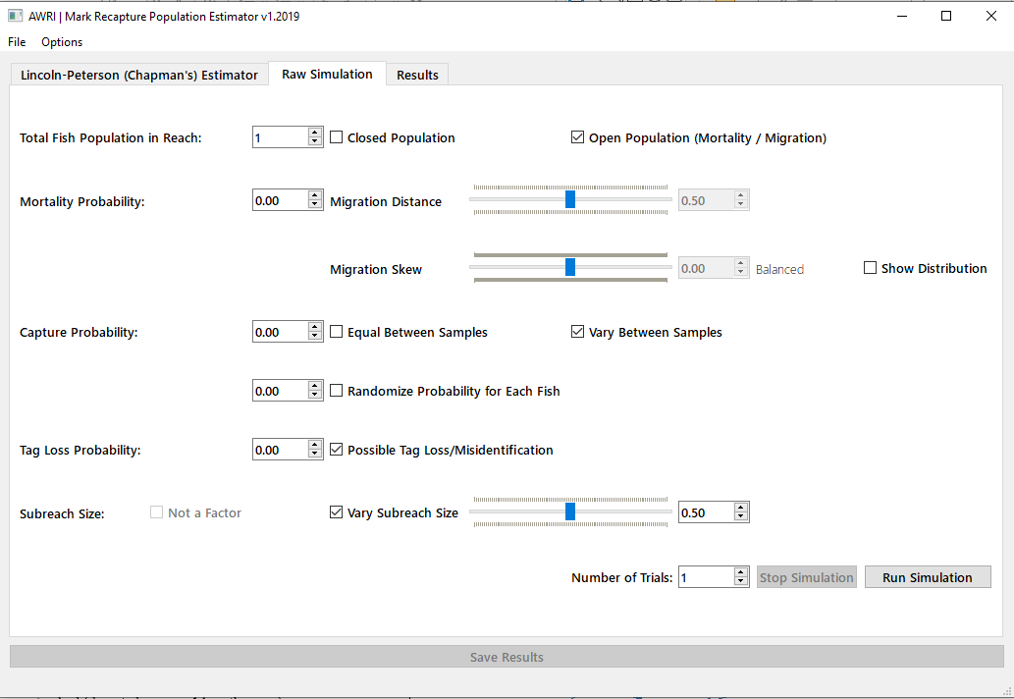
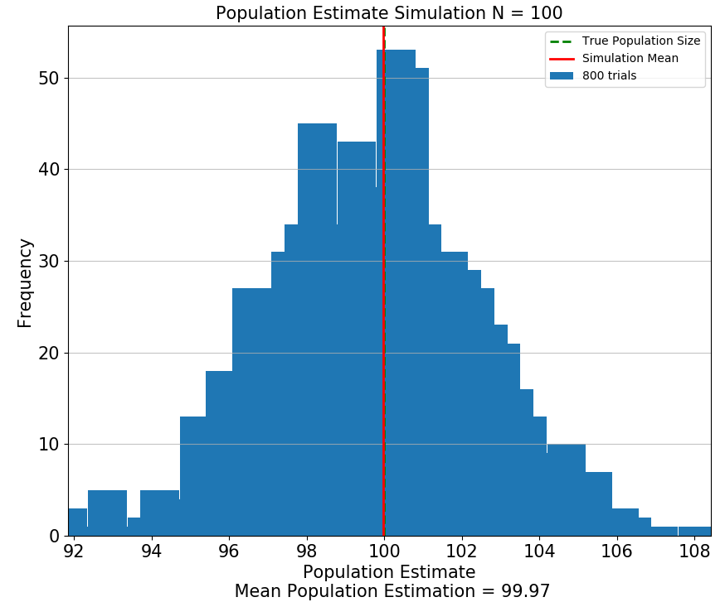
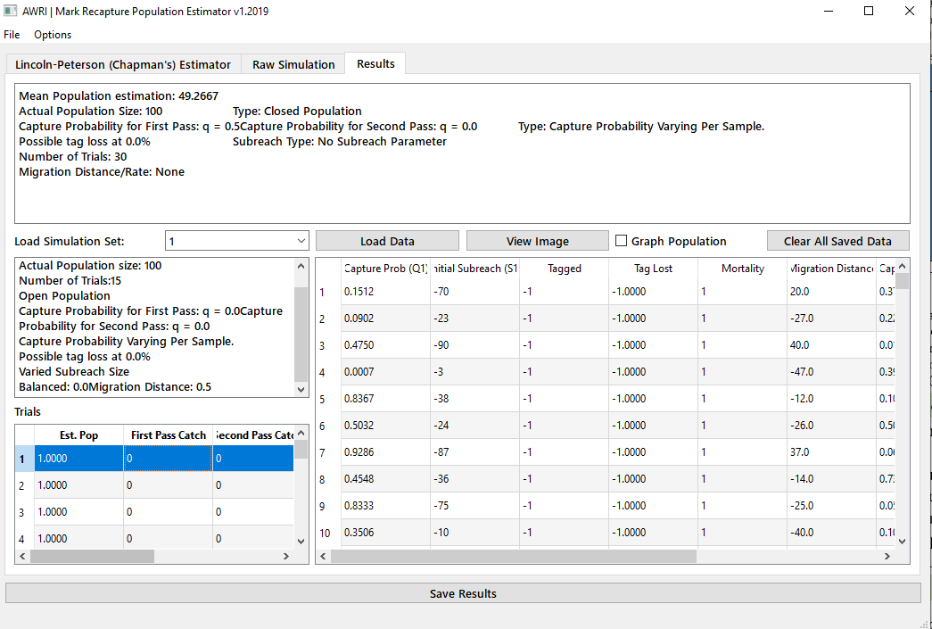
A New Computer Program to Evaluate Biases in the Two-Sample Mark-Recapture Abundance Estimator
Christian Yap, Carl R. Ruetz III, and James McNair
Annis Water Resources Institute, Grand Valley State University, Muskegon, Michigan
E-mail: yap@mail.gvsu.edu, ruetzc@gvsu.edu, mcnairja@gvsu.edu
Abstract
Sub-reach Size: The percent of the study area being sampled.
Number of Trials: The total number of times to repeat the simulation.
Two-sample mark-recapture sampling is a common method used to estimate stream fish abundance. The idea is to capture and mark fish in an initial sample. The fish are then released to mix randomly with the whole population. A second sample is obtained, and the number of marked and unmarked fish is recorded. The Chapman estimator uses the number of fish marked in the first sample, the total number of fish captured in the second sample, and the number of recaptured fish to estimate abundance. The assumptions are: 1) the population is closed, meaning no immigration, emigration, births, or deaths, 2) all fish are equally vulnerable to being captured during each sample, meaning marking does not change the behavior of fish, and 3) marks are not lost or overlooked. Violations of these assumptions can happen frequently and examining bias when a combination of assumptions are violated is difficult. To explore how simultaneously violating multiple assumptions of the Chapman estimator affects bias, we developed a computer simulation using Python software that allows the end user to assess bias by simulating a closed or open population, varying fish capture probabilities, and allowing fish to lose marks. The simulations allow the end user to experiment by intentionally violating any combination of model assumptions and determining the effect on estimator bias. This software should be useful to fisheries managers that use the Chapman estimator or instructors that teach the two-pass mark-recapture sampling for abundance estimation.
Introduction
Fig. 5. Filetypes available to users to save their simulation results.
2-sample mark-recapture is a commonly used method to estimate fish abundance.
For statistical estimators to be valid, the sampling method must meet certain assumptions.
Violating model assumptions can result in bias, and assessing the resulting bias is often difficult.
This computer software was developed to help users assess biases when assumptions of the abundance estimator are violated.
Fig. 2. The blue curve above shows a balanced beta distribution if a user decides to keep migration in and out of the reach equal. Upstream-biased movement is represented by the orange curve.
Results
Results are available in a variety of formats:
A Histogram Plot.
Textbox showing statistical data.
Table showing raw data for each trial run.
CSV, PNG files if user desires to export results
Fig. 6 Additional tab so that the user can estimate abundance from a sample using the Chapman estimator.
Technical Specifications
Executable for Windows Platforms.
Open-sourced code available on GitHub.
Multiprocessing to speed up simulations.
Fig. 1. Main graphical user window to begin use of the software.
Future Improvements
Methods
Fig. 3. A histogram plot to display simulation results.
Add visual simulation feature.
Refactor code to add in data structures and algorithm to further speed up simulations.
Upon start-up of software, a user can manipulate the following variables under the “Raw Simulation tab”:
Total Fish Population in Study Reach: Know fish abundance.
Closed or Open Population: With a closed population, there are no births, mortality, or movement in and out of the study reach (Figure 2).
Capture Probability: The chance of capturing a fish. This can be equal between all sampling or varied. It can also be completely random for each fish.
Tag Loss & Misidentification Probability: The chance of a fish losing its tag or a user not seeing the tag.
Acknowledgments
This research was made possible by the Bill & Diana Wipperfurth Student Research Scholarship. Special thanks to Grand Valley State University’s Office of Undergraduate Research and Scholarship (OURS) for providing travel funding through the Academic Conference Fund.
References
Hunter, J. D. 2007. "Matplotlib: A 2D Graphics Environment", Computing in Science & Engineering, vol. 9, no. 3, pp. 90-95.
McNair, J.N., C.R. Ruetz III, A. Carlson, and J. Suh. 2018. Reducing effects of dispersal on the bias of 2-sample mark-recapture estimators of stream fish abundance. PLoS ONE 13(8):e0200733.
Fig. 4. The text box on the upper screen summarizes conditions of the most recent simulation as well providing statistical analysis.
Notes:
-I did some reformatting up top on the poster- just to use as a reference and see how it looks. It might be best to just leave your “alan photo” off for space reasons. If you can fit a personal photo, I think it’s nice but in this case I just don’t’ think there’s room with the LRBOI logo.
-Abstract- “and the stock-tank RSI at Peterson Creek was 10-11% greater than single and triple-tank RSIs” – I know it makes the abstract more wordy and word limit is an issue, but this sentence is a little misleading since hatch for the the stock tank was 10-11% compared with singles and triples at Peterson Creek not singles and triples for the entire trial.
-Introduction- bullet 2- “that” needs to be added (Dan also noted this)
-You use “Fig. 1” “Fig. 2” and then “Figure 3” – not sure which is right – but just be consistent (also true for other figures.
-Figure 5 is missing
-Methods bullet 4- I would say single-tank and triple-tank : you have the room on the line and I think “single- “ looks funny.
-Figure 1. add (RSIs) after remote site incubators
-Figure 2- I agree with Dan- move labels closer to streams or even add an arrowing pointing to each stream. Also you have the open space on figure 1, maybe just spell out the full name of each creek instead of using abbreviations.
-Results Bullet 1- “We found no evidence that the black buckets heated the water temperature in RSIs (Fig. 3).” You can’t heat water temperature but you can raise the water temperature. I would change it to “We found no evidence that the black buckets raised the water temperature in RSIs (Fig. 3).”
-Results bullet 3- figure 5 no longer is included
-Results bullet 4- see comments above from abstract- I think you should specify you're comparing stock tank RSI and Peterson with the single and triples at Peterson- not the single and triple for the entire trial.
-Figure 3- very nit-picky on my part- but I think it would sound better like this: “Comparison of mean hourly water temperature (˚C) of the stream versus inside a remote site incubator (RSI).

